Slide 1
User Story Requirements
Identifier | User Story | Size
REQ-1 | As a user, I can add a new route on my account whenever I want | 3 pts
REQ-2 | As a user, only myself have access to check my routes and notes recently | 4 pts
REQ-3 | As a user, I can change and cancelled my route at any time | 4 pts
REQ-4 | System should automatically remind user when he has a route recently. | 4 pts
REQ-5 | As a user, I can share my route with my friends in Wechat. Friends can know our daily route by sharing | 7 pts
REQ-6 | As a user who is a Choister, The system recommends the arrangement for the day according to the user's recent schedule | 10 pts
REQ-7 | As a user, I can record my everyday-mood on the calender(such as sad, bravo, just so so) | 5 pts
REQ-8 | As a user,I can upload a file in memo as well as taking some notes | 4 pts
REQ-9 | System will form diagrams through analyzing user’s schedule monthly | 5 pts

Slide 2
Deriving Use Cases
Initiator | Initiator’s Goal | Participants | Use Case Name
User | To add, check, change cancel routes | User, Database | Route Arrangement(UC-1)
User | Check your note | Database | View route and memo(UC-2)
User | Remind user what to do | Timer | Reminder(UC-3)
Friend | Sharing user’s route with his friends | Database | Route-sharing(UC-4)
User | To help user find a best choice | Database | Route-recommendation(UC-5)
User | To record daily mood and draw a monthly conclusion with a diagram | Database | Record your life(UC-6)
User | User takes notes, upload file and photo | Database | Write Memo(UC-7)
User | Input username and password to login | User ,Database | Login(UC-8)

Slide 3
Traceability Matrix:
Traceability Matrix:
Req’t | UC1 | UC2 | UC3 | UC4 | UC5 | UC6 | UC7 | UC8
REQ1 | X |  | X | X | X
REQ2 | X | X |  | X |  |  |  | X
REQ3 | X |  | X | X |  | X
REQ4 |  |  | X
REQ5 |  |  |  | X
REQ6 |  |  |  |  | X
REQ7 |  |  |  |  |  | X | X
REQ8 |  |  |  |  |  |  | X
REQ9 |  |  |  |  |  | X

Slide 4
分工情况：
罗致远 | UC-4，user case diagram, traceability matrix
汪文烨 | UC-3
陈子浩 | UC-7,8
倪袁成 | UC1,2
陈以勒 | UC-5,PPT整理
张馨遇 | UC-6

Slide 5
Use Case UC-1: | Route Management
Related Requirements: | REQ-1，2，3
Initiating Actor: | User
Actor’s Goal: | To add, check, change and cancel routes
Participating Actors: | User, Database
Preconditions: | You have successfully opened the software and logged in.
Post Conditions: | /
Flow of Events for Main Success Scenario:
--> | 1.User open the software.
<-- | 2.User enter the username and password and log in.
--> | 3.User makes some change to his route by virtue of this software..

Slide 6
Test-case Identifier: | TC-1
Use Case Tested: | UC-1
Pass/fail Criteria: | The user can add or cancel his route.
Input Data: | New route.
Test Procedure | Expected Result:
Step1: add a new route to his table of routes. | System indicate this failure; records unsuccessful attempt in the database; prompts the user to try again.
Step2: cancel a existed route from his table. | System indicate success; records successful change in the database;

Slide 7
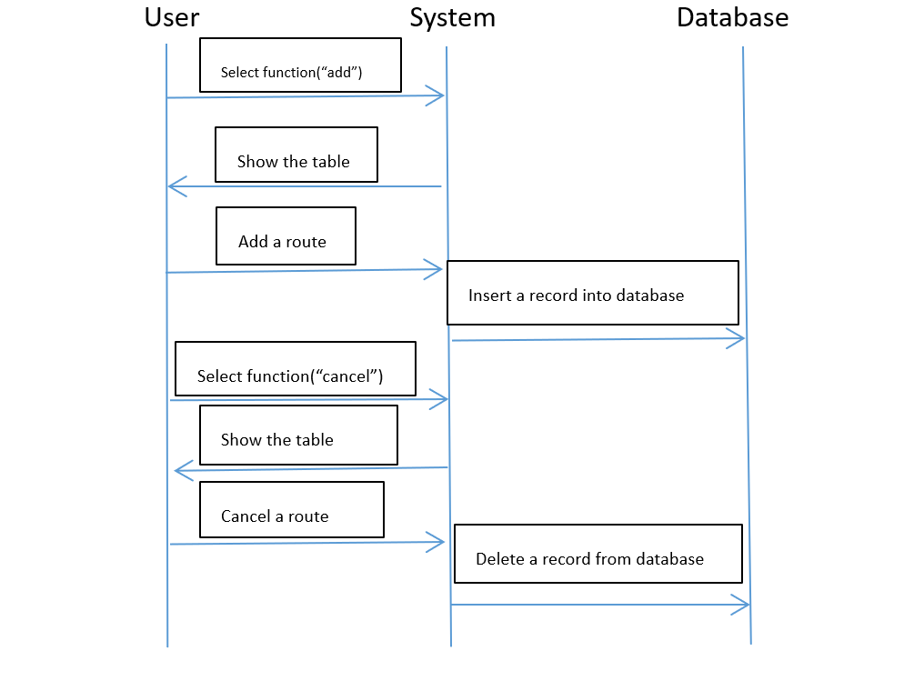

Slide 8
Use Case UC-2: | View route and memo
Related Requirements: | REQ-2
Initiating Actor: | User
Actor’s Goal: | only the user has authority to check his notes.
Participating Actors: | User, Database
Preconditions: | You have successfully opened the software and logged in.
Post Conditions: | /
Flow of Events for Main Success Scenario:
--> | 1.User open the software.
<-- | 2.User enter the username and password and log in.
--> | 3.User check his notes and memo recently.

Slide 9
Test-case Identifier: | TC-2
Use Case Tested: | UC-2
Pass/fail Criteria: | Only the user can check his notes and routes
Input Data: | /
Test Procedure | Expected Result:
Step1: the user check his own routes and notes. | The system allows access.
Step2: the other person except the user try to check the user’s recent routes. | the system reject his application.

Slide 10
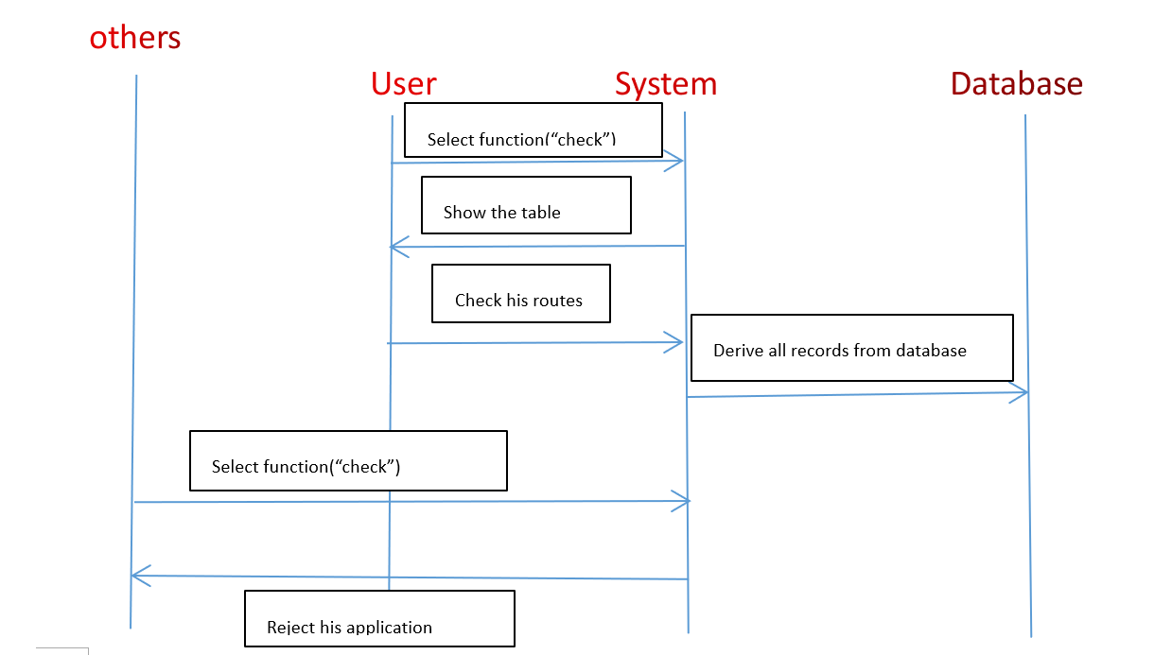

Slide 11
Use Case UC-3: | Reminder
Related Requirements: | REQ-1，3，4
Initiating Actor: | System
Actor’s Goal: | System automatically reminds user when he recently has a route.
Participating Actors: | User,Database
Preconditions: | 1.The user has added routes(including information about time、content and so on) into the database. 2.The system displays the button so that users can decide whether the route needs reminding or not when it is being added and the user choose ‘Needing Reminder’.
Post Conditions: | /
Flow of Events for Main Success Scenario:
--> | 1.User is adding a new event
<-- | 2.Show the menu of editing memo.
--> | 3.User presses the choice of ‘Needing Reminder’ and chooses when system should remind and the frequency of alerting.
<-- | 4.save the state into database.
--> | 5.System pops up the windows of reminding showing the event been added and approaching.
<-- | 6.User presses the confirming button.

Slide 12
Test-case Identifier: | TC-3
Use Case Tested: | UC-3
Pass/fail Criteria: | The reminder performs seasonably and accurately.
Input Data: | Datetime
Test Procedure | Expected Result:
Step1: add a new event and choose ‘No Needing’ to wait if the system will remind. | The system doesn’t perform as a reminder.
Step2: add a new event and choose ‘Needing Reminding’ | The system reminds in accurate time and frequency.
Step3:add a new event which has been set as needing and then Turn it into ‘No needing’. | The system doesn’t remind.
Step4: add a new event and choose ‘Needing Reminding’ | The system reminds in the modified way

Slide 13
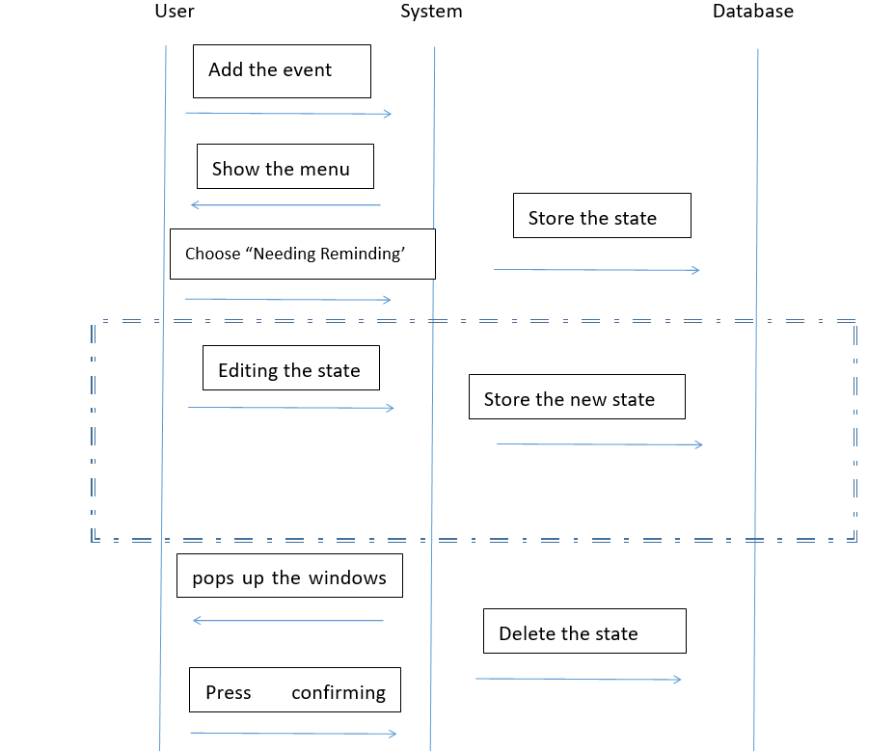

Slide 14
Use Case UC-4: | Route sharing
Related Requirements: | REQ-1，2，3，5
Initiating Actor: | User, Friend
Actor’s Goal: | To share your daily routine with friends
Participating Actors: | Database
Preconditions: | 1. Friends need to be authorized before view user’s route. 2. The system displays user’s route to friends
Post Conditions: | Friend see what’s going on in real time
Flow of Events for Main Success Scenario:
--> | 1. user grants permission to friends
<-- | 2. System: signals to display user’s route to friends.
--> | 3. User changes route
<-- | 4. System show these changes to friend

Slide 15
Test-case Identifier: | TC-4
Use Case Tested: | UC-4
Pass/fail Criteria: | Whether friends can actually see what’s going on with user after having been authorized.
Input Data: | User’s route,authorizing
Test Procedure | Expected Result:
Step1: Give access to friend’s account | System reminds you can see user’s route
Step2: Don’t give access to friend’s account | System warns that you can’s have access to seeing other’s route
Step3:See what happened after Step 1 | System display you your friend’s route in real time

Slide 16
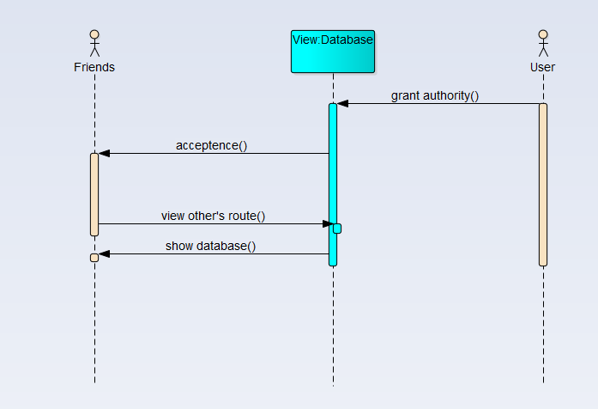

Slide 17
Use Case UC-5: | Route sharing
Related Requirements: | REQ-1，6
Initiating Actor: | User
Actor’s Goal: | Help user find a best choice.
Participating Actors: | Database, User
Preconditions: | 1.The user has the jurisdiction to add routes. 2. Screen displays a recommendation button to bring the user to the recommendation page.
Post Conditions: | The route selected by the user will be recorded in the database
Flow of Events for Main Success Scenario:
--> | 1.User press the button which enables user to enter the interface of recommendation.
<-- | 2. System shows "auto-recommend" and "custom" buttons
--> | 3.User selects recommended routes, or the system randomly selects user-defined routes
<-- | 4. Shows a confirmation pop-up for the user to confirm
--> | 5. User selects the confirm button
 | 6.include::Add_route(UC-1)

Slide 18
Test-case Identifier: | TC-5
Use Case Tested: | UC-5
Pass/fail Criteria: | The user successfully selects a recommended route and the route is added to the database.
Input Data: | User’s route
Test Procedure | Expected Result:
Step1: Select the button which enables users to enter the interface of recommendation. | shows " auto-recommend" and "custom" buttons
Step2: Select the " auto-recommend" button | Show relevant pages for users to select routes.
Step3: Select any of the routes | Shows a confirmation pop-up for the user to confirm
Step4: Select the "customize " button | Show relevant page for users to fill in the routes.
Step5: Select the submit button | Randomly recommend a route and ask for confirmation
Step6: Select the confirmation button | The route is added to the database

Slide 19
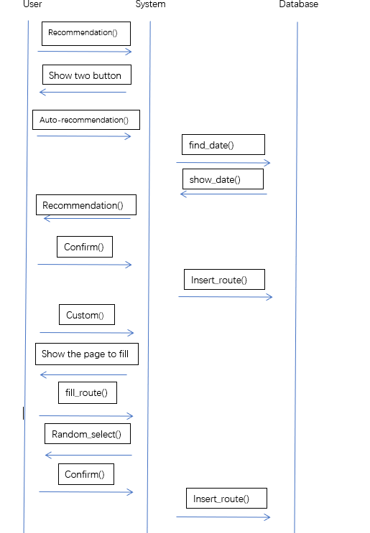

Slide 20
Use Case UC-6: | Record your life
Related Requirements: | REQ-3,7,9
Initiating Actor: | User
Actor’s Goal: | To record everyday-mood and draw a monthly conclusion with a diagram
Participating Actors: | Database, User
Preconditions: | 1.Routes exist in the database. 2.The user has the jurisdiction to add and cancel everyday-mood. 3.Routes can be classified in specific ways.
Post Conditions: | Everyday-mood added or deleted successfully; according to route type, database draws different charts.
Flow of Events for Main Success Scenario:
--> | 1.The user presses the button to select the mood of the day.
<-- | 2.Successfully added and displayed.
--> | 3.The user presses the button to select the chart to view.
<-- | 4.System analyzes the chart according to the selected type. Save the chart to the database.
--> | 5. User can view chart successfully.

Slide 21
Test-case Identifier: | TC-6
Use Case Tested: | UC-6
Pass/fail Criteria: | Whether the everyday-mood added successfully; Whether the chart correspond to the time and label in route.
Input Data: | user’s route, authorizing, time, time plug-in
Test Procedure | Expected Result:
Step 1:Users enter the route of the day, click the add mood button and select different mood tags. | If the selection is successful, the window of adding success will be displayed; otherwise, the window of adding failure will be displayed.
Step 2:Click the chart button and select different charts to display | It will display different tables (line chart, bar chart, etc.)
Step 3:Select chart for different months | Show route chart for different months.
Step 4:Select category tag | A chart showing the label

Slide 22
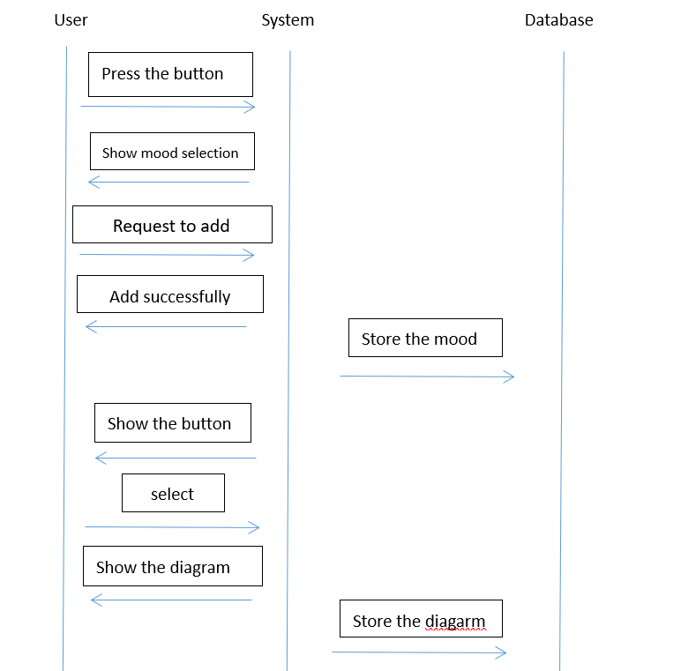

Slide 23
Use Case UC-7: | Write Memo
Related Requirements: | REQ-7,8
Initiating Actor: | User
Actor’s Goal: | User takes notes,upload file and photo
Participating Actors: | Database, User
Preconditions: | 1.The user has the jurisdiction to take notes,upload file and photo. 2.The system displays the button which enables user to enter the interface of memo.
Post Conditions: | What the user has uploaded should be stored into database.
Flow of Events for Main Success Scenario:
--> | 1.User press the button which enables user to enter the interface of memo
<-- | 2.Show the menu of editing memo.
--> | 3.User press the takes notes button and write in some words.
<-- | 4.Show and save the words into database.
--> | 5.User press the upload file button and upload a file.
<-- | 6.Show and save the file into database.
--> | 7.User press the upload photo button and upload a photo.
<-- | 8.Show and save the photo into database.

Slide 24
Test-case Identifier: | TC-7
Use Case Tested: | UC-7
Pass/fail Criteria: | All the buttons related to this model can run successfully.
Input Data: | Strings, files and photos.
Test Procedure | Expected Result:
Step 1:Press the button which enables users to enter the interface of memo. | Show the menu of editing memo.
Step2: Press the takes notes button and write in some words. | Show the notes and we can see the notes saved into database.
Step3: Press the upload file button and upload a file. | Show the file and we can see the file saved into database.
Step4: Press the upload photo button and upload a photo. | Show the photo and we can see the photo saved into database.

Slide 25
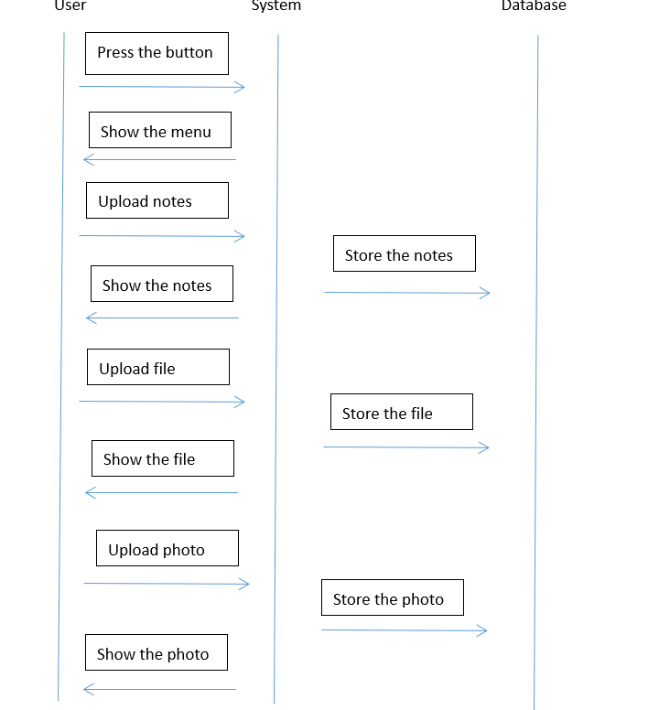

Slide 26
Use Case UC-8: | Login
Related Requirements: | REQ-2
Initiating Actor: | User
Actor’s Goal: | To login the software and get the limits of authority to check or modify his/her route.
Participating Actors: | Database, User
Preconditions: | The set of valid username and passwords in the system database is non-empty. 2.The system displays the menu of login with the blocks to put in username and passwords.
Post Conditions: | /
Flow of Events for Main Success Scenario:
--> | 1.User open the software.
<-- | 2.Show the login menu.
--> | 3.User enter the username and passwords.
<-- | 4.If the password is right enter the main menu.

Slide 27
Test-case Identifier: | TC-8
Use Case Tested: | UC-8
Pass/fail Criteria: | The test passes if the user enters a username and the right passwords that is contained in the database. And enter the main menu successfully.
Input Data: | user’s route, authorizing, time, time plug-in
Test Procedure | Expected Result:
Step1: Put in a wrong username which is not in the database. | Show that the username can not be found.
Step2: Put in a right username which is in the database but wrong passwords. | Show that the passwords is wrong.
Step3: Put in a right username and a right passwords which are in the database. | Show that both the username and the passwords are correct and enters into the main menu.

Slide 28
